Slide 1
Jimi Hendrix
By: Cheyenne and Mary

Slide 2
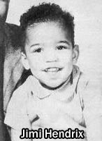
His childhood
Jimmy Hendrix was born with the name of Johnny Allen Hendrix (later his name was changed changed to James Marshall) on November 27,1942. his mother, Lucille, was only 17 years old when he was born. His mother and his father, Al, had a stormy relationship. After his two brothers (Leon and Joseph) were born. He did not see his mother often.
All photos from Biography.com

Slide 3
Musical Aspirations
He really liked blues music and taught himself to play the guitar. At 14, he saw Elvis Presley preform. The next year he got his first electric guitar. He plays a backwards/upside-down guitar, and holds the neck in his right hand. He plays with the high strings on the bottom and the bass strings on the top of the guitar. (The strings are strung for a left hand position). He mostly uses a Stratocaster with fonder light gauge strings. He also has two Gibsons. He eventually played with two bands- the Rocking Kings and the Tomcats. After his drop out in high school, he worked odd jobs while continuing to work on his music. In 1961 he went into the United States Army and still made time for music. While in the army he created a band named The King Casuals. He was discharged from the Army in 1962 due to an injury. After leaving the Army Hendrix formed a band called the Jimmy James and the Blue Flames.

Slide 4
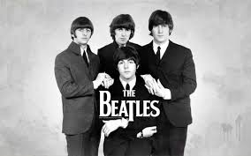

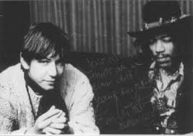
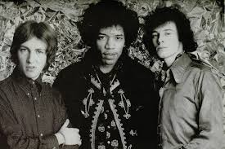
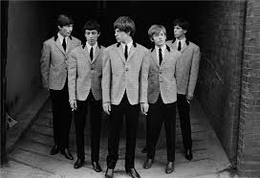

Career Breakthrough
Jimi Hendrix with Noel Redding and Mitch Mitchell in the Jimi Hendrix Experience.
Jimi Hendrix when he met Chas Chandler.
All photos from Biography.com
Musicians who admired Hendrix’s work: The Beatles, The Rolling Stones, The Who and, Eric Clapton.

Slide 5
Tragic Death
On September 18, 1970 Hendrix died from barbiturate overdose. He was only 27 years old. He left his mark on rock music and is still popular today. Berkeley Tribe wrote that “Jimi Hendrix could get more out of an electric guitar then anyone else. He was the ultimate player.”

Slide 6
Bibliography
Unknown. Rock Guitarists. New York:
All Rights Reserved, 1975.
The Biography.com Editors. “Jimi Hendrix.”
Biograph.com September 24, 2015 A&E Television Network.

