Slide 1
The Dewey Decimal Classification System
By Lori Applegate

Slide 2
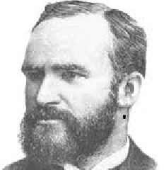
Who was Melvil Dewey?
Melvil Dewey
Was a librarian who created the Dewey Decimal Classification System in 1873 when he was 22 years old, and published it in 1876.
Dewey believed that if libraries used one system to organize their books then people could find their books in any library.
Dewey’s system organized books into subject categories instead of alphabetical in the non-fiction. Now books could be placed on the shelves with other books that are about the same subject.
Mr. Dewey helped to establish the very first school for librarians at Columbia University.
Mr. Dewey helped to establish the American Library Association, which is a very important organization for libraries all over the United States.
Mr. Dewey passed away when he was 80 years old in 1931.

Slide 3
Definition of the Dewey Decimal Classification System
Dewey Decimal Classification System Definition:
Is a system to organize books, and other materials, on the library shelves, so that we can find them.
Each book, or other item, has a call number which is the books address for locating it on the shelf.
The call number is located on the books spine.
The Dewey Decimal Classification System has 10 main classes for organizing books and other library items.

Slide 4
10 Main Classes of the Dewey Decimal Classification System
The Ten major headings in DDC are:
000 Generalities
100 Philosophy and Psychology
200 Religion
300 Social sciences
400 Language
500 Natural sciences & mathematics
600 Technology (Applied sciences)
700 The Arts
800 Literature & rhetoric
900 Geography & history

Slide 5
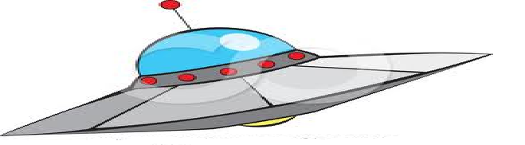


000 – Generalities
001.9 Weird Stuff like Bigfoot, Loch Ness Monster & UFO’s
004 Computers & The Internet
027 Libraries
030 Guinness Book of World Records
031 World Almanac
060 Museums
070 Newspapers

Slide 6

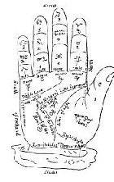
100 – Philosophy Psychology & Unexplained Phenomena
133.1 Ghost
133.4 Witchcraft
133.5 Astrology
152.1 Optical Illusions
155.93 Death & Dying
170 Values

Slide 7




200 – Religion
200’s Bible Stories
230 Christianity
290-291 Mythology
292 Greek & Roman Mythology
292 Norse Mythology
296 Judaism

Slide 8
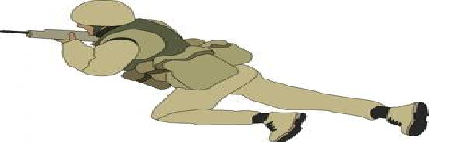



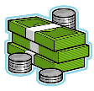



300 – Social Studies
305.89 Indians of North America
306 Families
306.89 Divorce
307 Communities
320’s Government
324.6 Elections
330’s Careers
332.4 Money
355 – 359 Army & Navy
362 Handicaps
363 Environmental Issues
363.23 Police
394.2 Holidays
398.2 Folklore & Fairy Tales
398.8 Mother Goose & Nursery Rhymes

Slide 9



400 – Language
419 Sign Language
423 Dictionaries
430 German
440 French
450 Italian
460 Spanish
461.7 Russian
492 Hebrew
495.1 Chinese
495.6 Japanese

Slide 10






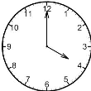



500 – Science & Math
507.8 Science Experiments
510’s Math
520’s Planets & Stars
525 Earth
529 Time
537 Electricity
538 Magnets
549 Rocks & Minerals
551.2 Volcanoes
551.5 Weather
552 Rock Collecting

Slide 11













500 – Science & Math Cont.
567.9 Dinosaurs
582 Trees
591 Zoology
594 Mollusk (clams, snails, octopuses, squids)
595.3 Crustaceans
595.4 Spiders
595.7 Insects
597.06 Fish
597.3 Sharks
597.6 Amphibians (salamander, newt, toad, frog)
597.9 Reptiles (turtles, lizards, snakes, alligator, crocodile)
598.2 Birds
599 Mammals
599.1 Platypus
599.2 Marsupials (kangaroos, opossums)
599.3 Rodents, rabbits, anteaters

Slide 12




500 – Science & Math Cont.
599.4 Bats
599.5 Whales & dolphins
599.7 Carnivores (rhinos, seals, bears, wild cats, wild dogs, bison, camels, deer, seals, giraffe, raccoon, walrus)
599.8 Primates (monkey, apes)

Slide 13








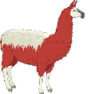

600 – Technology
600 The Way Things Work
608 Inventions
610’s The Body
623 Boats
625 Trains
629’s Vehicles (Airplanes, helicopters, cars, trucks, space ships)
635 Gardening
636.1 Horses
636,2 Cows & llamas
636.3 Sheep & goats

Slide 14






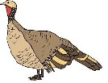
600 – Technology Cont.
636.4 Pigs
636.5 Poultry (chickens, turkeys, ducks)
636.7 Dogs
636.8 Cats
641.5 Cookbooks
686 How a book is made
690’s How buildings are made

Slide 15








700 – The Arts & Sports
700-709 Art History and artist
741 How to draw
745.5 Crafts
770 Photography
784 Song Books
791.3 Circus
791.4 Movies
791.5 Puppets
792.8 Ballet
793.8 Magic Tricks

Slide 16




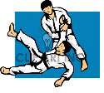

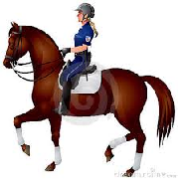


700 – The Arts & Sports Cont.
794 Games
796.2 Skateboarding
796.32 Basketball
796.33 Football
796.334 Soccer
796.357 Baseball
796.7 Auto racing
796.8 Martial Arts
796.9 Snowboarding
798.2 Horseback Riding

Slide 17





800 – Literature
808 How to Write
808.81 Poetry Collections
808.83 Short Stories
811 American Poetry
812 Plays
818.54 Jokes and Riddles

Slide 18
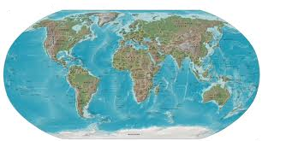

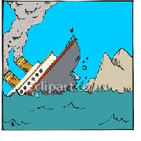

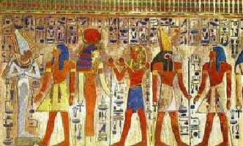
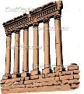
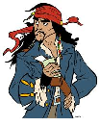
a
900 – Geography & History
910.4 Shipwrecks
910.4 Pirates & Explorers
912 Atlases
914-916 Countries of the World
917 United States
917.4 New Hampshire
929.9 Flags
932 Ancient Egypt & Mummies
937 Roman History
938 Greek History

Slide 19
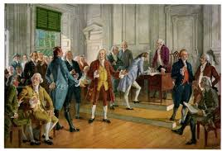
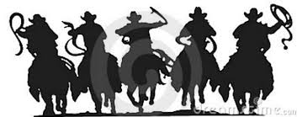
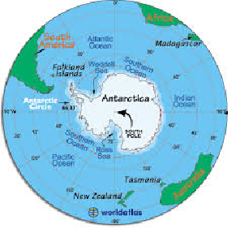

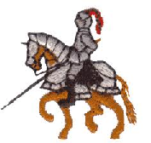
900 – Geography & History Cont.
940 Middle Ages and Knights
973 US History
978 Cowboys & the Wild West
998 Arctic & Antarctica

Slide 20
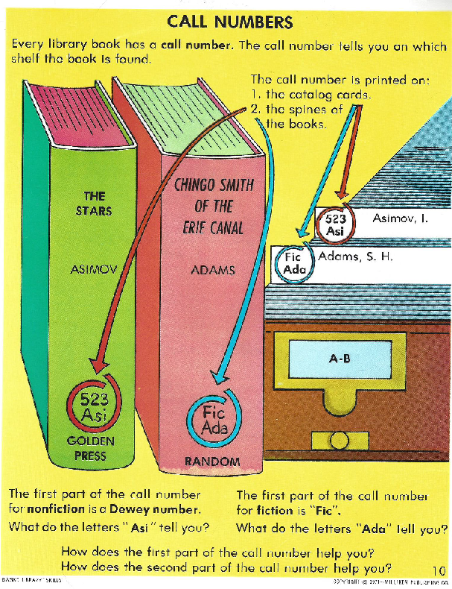

Slide 21
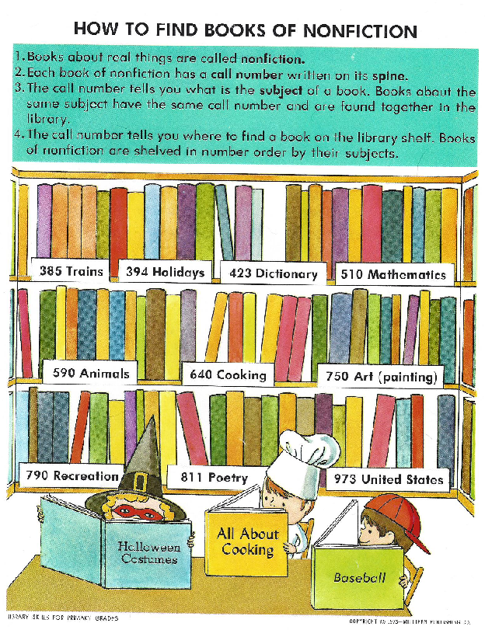

Slide 22
The Dewey Decimal Classification System: Call Numbers
Again in this DDCS there is a call number on the spine of each book, or other library item, that is like the address for the book. We find books on the shelf using their call number (address).
The books (or items) are put on the shelf in number order.
749.1 App | 749.12 Sep | 749.12 Bea | 749.13 Dea | 751.01 Aya | 751.23 Aya

Slide 23
Call Numbers/Book Addresses
Non-fiction books are put on the shelf by number, and then by the first three letters of the author’s last name (Cutter line).
749.1 App | 749.1 Bea | 749.1 Cod | 749.1 Dea | 751.01 Aya | 751.01 Cod

Slide 24
Fiction Call Numbers
Mr. Dewey originally put fiction under category 800 (810) of the DDCS.
There are too many fiction books to fit in the non-fiction section, so fiction books have their own sections in the library.
A fiction call number is made up of the first three letters of the author’s last name.
Example:
E F
Bre
Cle

Slide 25
Locating Fiction Books on the Shelf
Fiction books, and other items, are found on the shelf in alphabetical order by the first three letters of the authors last name.
Example:
F App | F Bea | F Bre | F Dea | F Nod | F Sta

Slide 26
Review
Review Questions
Who is the person who created the Dewey Decimal Classification System?
What is the Dewey Decimal Classification System?
How many main categories are there in the DDCS?
What is a call number?
What does a fiction call number look like?
What does a non-fiction call number look like?

Slide 27
Review Answers
Review Question Answers
1. What is the Dewey Decimal Classification System?
Answer: It is a system to organize books, and other materials, on the library shelves, so that we can find them.
2. Who is the person who created the Dewey Decimal Classification System?
Answer: Melvil Dewey
3. How many main categories are there in the DDCS?
Answer: 10
4. What is a call number?
Answer: A call number is the books address on the library shelves.
5. What does a fiction call number look like?
Answer: A fiction call number has the first three letters of the author’s last name.
6. What does a non-fiction call number look like?
Answer: A decimal number for the books’ subject, and the first three letters of the author’s last name.

Slide 28
The End
Sources:
Basic library skills, n.d. (1971). Wilkinsberg, PA: Milliken Publishing Company. (Authors name not available)
Information on the Dewey Decimal Classification taken from: Weisburg, H. & Toor, R. Teacher’s Portfolio of Library Skills Lessons & Activities (1985).
The Center for Applied Research in Education, Inc.
Campbell, L., Knight Mayfield, L., & Smith, G. (1989). A student's guide on how to use a library.
Wilkinsburg, PA: Hayes School Publishing Company.
How to Find Items in the Library. (2013). Retrieved from http://www.ais.up.ac.za/vet/infomania/infomania14/dewey14.htm
Dewey Decimal System at pppst.com, The Numbers in Non-Fiction Power Point, retrieved from: http://languagearts.pppst.com/deweydecimals.html
Library Skills for Primary Grades, n.d. (1973). Milliken Publishing Company, 1973 (Authors name not available)

